Slide 1
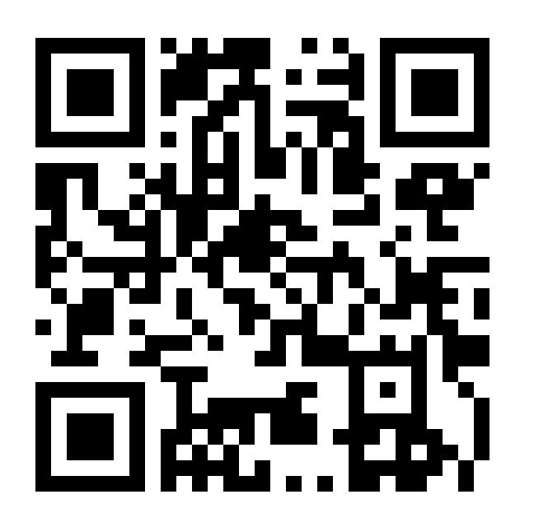

Connect to
NinerWifi-Guest
Open
Website
Then, VOTE!

